Slide 1
Neural Networks
Course Outline:
Introduction and historical background, Feedback and Network Architectures, Learning, Perceptrons, Perceptron Convergence Theorem, Correlation Matrix, Least Mean Square Algorithm, Back Propagation, Multilayer Perceptrons, Cross Validation / Function Approximation, Adapting Learning Rates, Fuzzy Learning / Radial Basis Function, Radial Basis Function Networks, Hopfield Networks, Simulated Annealing, Boltzmann Machines, Mean Field Theory, Self Organizing Systems, Self-Organizing Feature Map, Information Theoretic Models, Introduction to Genetic Algorithm, Application of Neural Network to Image Processing and Power System Analysis
Shashidhar Ram Joshi
Institute of Engineering

Slide 2
References:
1. Simon Haykin, “Neural Networks: A Comprehensive Foundation”, Pearson Education Asia, 2001.
2. Bart Kosko, “Neural Networks and Fuzzy System”, Prentice-Hall of India Private Limited, 2001.
3. B. Yegnanarayana, “ Artificial Neural Networks”, Prentice-Hall of India Private Limited, 2001.
4. Robert J. Schalkoff, “ Artificial Neural Networks”, McGraw-Hill International Editions, 1997.
Evaluation
External Examination: 60%
Internal Examination: 40%
1. Assignment 10%
2. Test 10%
3. Project 10%
4. Seminar Presentation 10%

Slide 3
Human Brain
Computers and the Brain: A Contrast
  Arithmetic: 1 brain = 1/10 pocket calculator
  Vision: 1 brain = 1000 super computers
  Memory of arbitrary details: computer wins
  Memory of real-world facts: brain wins
  A computer must be programmed explicitly
  The brain can learn by experiencing the world

Slide 4
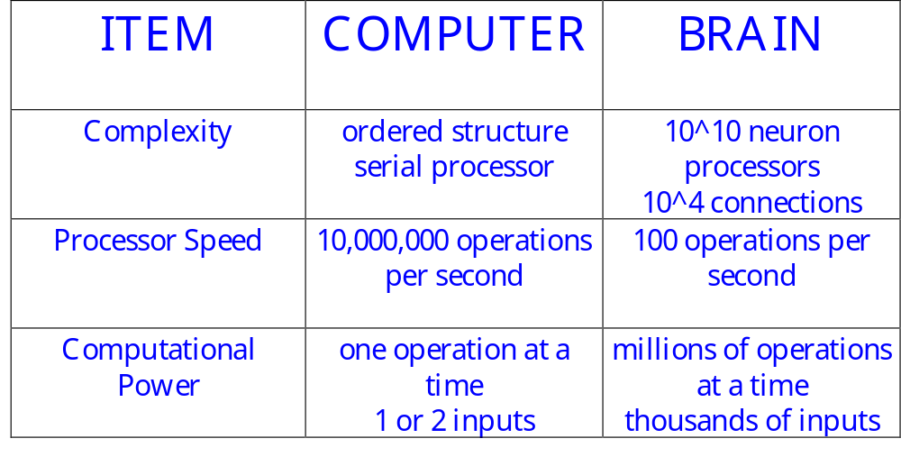
Other Comparisons

Slide 5
Computer Operations
Traditionally computers execute a sequence of instructions to accomplish a set task
    This is a powerful technique if you know the ‘algorithm’
    It’s not very useful if you don’t !!
There are many interesting tasks where the algorithm is either unknown or unclear
    Recognizing handwriting - Pattern recognition
    Playing table tennis - Interacting with the environment
    Balancing activities - Optimization

Slide 6

The Question
  Humans find these tasks relatively simple
    We learn by example
    The brain is responsible for our ‘computing’ power
If a machine were constructed using the fundamental building blocks found in the brain could it learn to do ‘difficult’ tasks ???

Slide 7
Definition
“. . . Neural nets are basically mathematical models of information processing . . .”
“. . . (neural nets) refer to machines that have a structure that, at some level, reflects what is known of the structure of the brain . . .”
“A neural network is a massively parallel distributed processor . . . “

Slide 8
Neural Net Concept
Artificial Neural Systems are called:
  neurocomputers
  neural networks
  parallel distributed processors
  connectionists systems
Basic Philosophy
  large number of simple “neuron-like” processors which execute global or distributed computation

Slide 9
Neural Nets vs Standard Computing
NN are different from
  Parallel Processors - if you look at one processor in a typical parallel system, its work makes sense
  Contemporary AI – no algorithms

Slide 10
Processing Comparisons
INPUT
(Type)
OUTPUT
(Procedural)
Data Input
Conventional Processing
Procedures applied to data
Data Output
1, 2, 3, etc.
(Logical)
Facts
Expert/Knowledge-Based System
Inference Engine & Knowledge (Rules)
Decision Recommend
(A is True)
(Statistical)
Patterns
Neural Networks
Network Algorithm Identifies Patterns
Pattern recognized

Slide 11
History of NN
Creation:
  1890: William James - defined a neuronal process of learning
  1911: Ramon y Cajal (1911) introduced the idea of a neuron (brain cell)
  Promising Technology:
  1943: McCulloch and Pitts - earliest mathematical models
  1954: Hebb and IBM research group - earliest simulations
  1958: Frank Rosenblatt - The Perceptron
Disenchantment:
  1969: Minsky and Papert - perceptrons have severe limitations
Re-emergence:
  1985: Multi-layer nets that use back-propagation
  1986: PDP Research Group - multi-disciplined approach

Slide 12
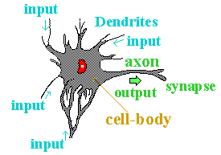
Biological Neurons
A neuron consists of two main parts:
  Axon
    one per neuron
    excites up to 10⁴ other neurons
    all or nothing output signal
  Dendrites
    1 to 10⁴ per neuron
The connection between an axon of one
neuron and the dendrite of another is called
a synapse

Slide 13
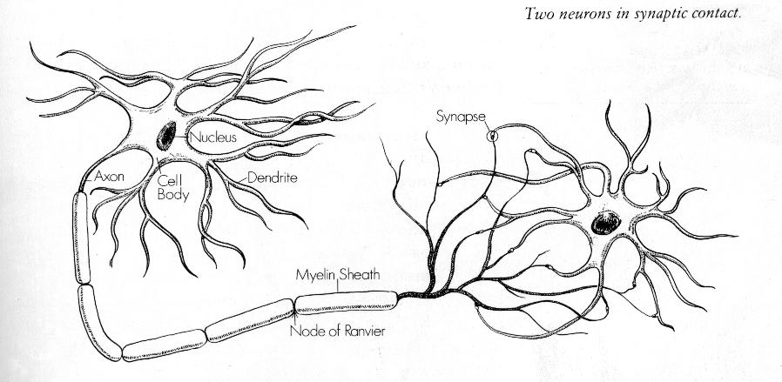
Two Neurons

Slide 14
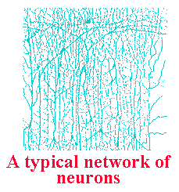
Properties of the Brain
Architectural
  80,000 neurons per square mm
  10¹¹ neurons - 10¹⁵ connections
  Most axons extend less than 1 mm (local connections)
Operational
  Highly complex, nonlinear,
  parallel computer
  Operates at millisecond speeds

Slide 15
Interconnectedness
Each neuron may have over a thousand synapses
Some cells in cerebral cortex may have 200,000 connections
Total number of connections in the brain “network” is astronomical—greater than the number of particles in known universe

Slide 16
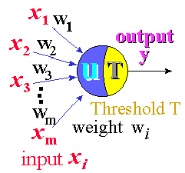
Artificial Neuron
An artificial neuron is designed to mimic the first-order characteristics of a biological neuron
A set of inputs, x_{i}
Each input is multiplied
by the corresponding
weight, w_{i}
All of the weighted inputs
are summed to determine
the activation level
An activation function is applied to determine
the neuron output

Slide 17

Mathematical Structure
A neuron is a simple sum and compare device
u = x₁w₁ + x₂w₂ + . . . x_{n}w_{n} - T
y = f(u)
threshold
One possible function for y is a step function:
If the weighted sum of the inputs is greater
than the threshold, then the neuron “fires”

Slide 18
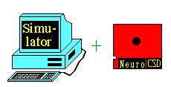

Applications of Neural Nets
Applications 1
There are a variety of applications (both research and commercial) of neural nets
Simulations
special software that
implements NN on
standard computers
Hardware emulation
special hardware
coprocessors

Slide 19
Applications 2
Diagnosis
  Closest to pure concept learning and classification
  Some ANNs can be post-processed to produce probabilistic diagnoses
Prediction and Monitoring
  aka prognosis (sometimes forecasting)
  Predict a continuation of (typically numerical) data
Decision Support Systems
  aka recommender systems
  Provide assistance to human “subject matter” experts in making decisions
    Design (manufacturing, engineering)
    Therapy (medicine)
    Crisis management (medical, economic, military, computer security)
Control Automation
  Mobile robots
  Autonomic sensors and actuators
Many, Many More (ANNs for Automated Reasoning, etc.)

Slide 20
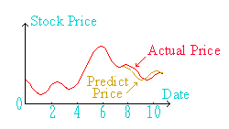
Applications 3
Other applications include:
Stock Price Prediction:
Data for past stock prices are learned by neural
networks, and their trends for one or a few days
ahead are predicted.
Signature Check:
For checking a signature of a person, first we train
the neural networks to recognize that signature by
learning several writing features such as strength of
the pen, direction, and any special point of that
sample. After learning, the neural network can
check whether a signature belongs to the same
person or not.

Slide 21

Applications 4
The Boeing Airplane Company uses an ART-1 neural network system (NIRS) for the identification and retrieval of 2-D and 3-D representations of engineering designs.
Avoids redesign of existing parts and tools
Production solid model data base > 55,000 entries
2-D data base > 95,000 entries

Slide 22
Applications 5
Credit Card Fraud Detection
  The probability of fraud is calculated with a neural network with each card transaction. When the probability of fraud reaches a critical threshold, the case is sent to one of the retailer's fraud analysts for action.

Slide 23
Possible Quiz
What are the two parts of a neuron?
What is it that humans do much better than machines?
What is one application of a neural net?
SUMMARY
Introduction to Neural Nets
Applications of Neural Nets

